Slide 1





Understanding, Integrating, and Discussing Data with LLMs
Ioannis Dasoulas, Duo Yang, Xuemin Duan, Anastasia Dimou
DTAI, KU Leuven
{first_name.last_name}@kuleuven.be

Slide 2
Data understanding is fundamental across industries…
Data understanding: Comprehending data’s meaning, qualities, structure
Crucial for:
Data cleaning
Data integration
Machine learning
Data Analysis / Knowledge discovery
Notes:
For all projects that involve data, understanding data in depth is one of the most fundamental steps that is often underestimated
Tasks: Whether we are cleaning data, integrating multiple datasets, or building machine learning models, the quality of the results depends on how well we understand the structure and meaning of the data.

Slide 3
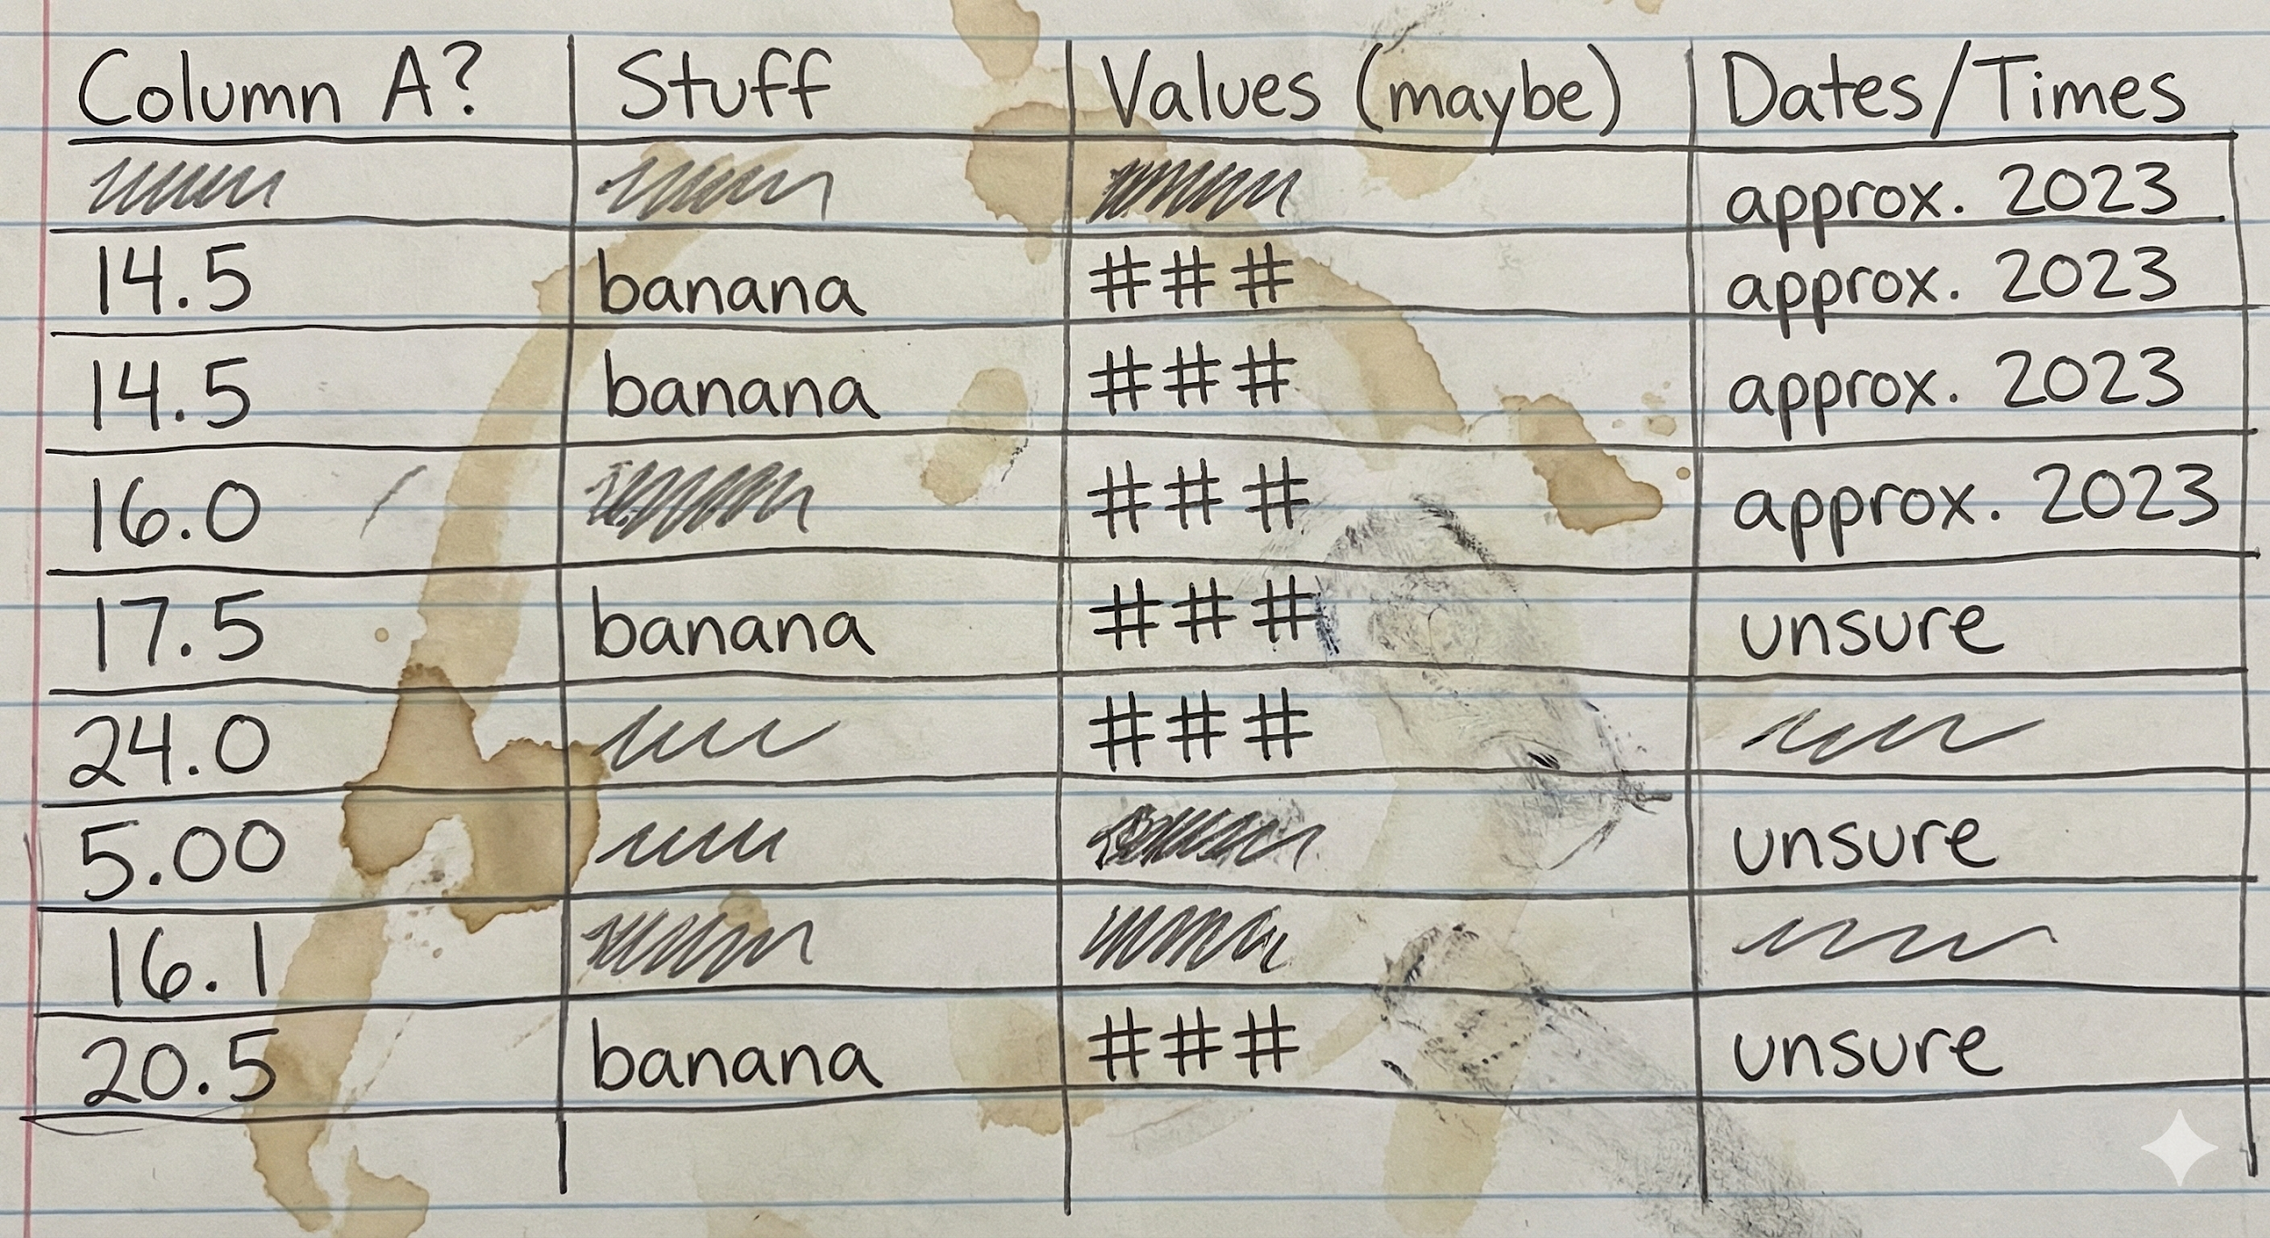
… but presents many challenges
Data understanding challenges:
Low quality of data (e.g. missing data or lack of structure)
Data ambiguity (meaning changes depending on context)
Understanding varies depending on the task
Notes:
For all projects that involve data, understanding data in depth is one of the most fundamental steps that is often underestimated
Tasks: Whether we are cleaning data, integrating multiple datasets, or building machine learning models, the quality of the results depends on how well we understand the structure and meaning of the data.

Slide 4
Need for accurate data understanding as scale
Our work focuses on:
Data understanding systems using data retrieval techniques and LLMs
Application of data understanding in :
Data enrichment
Data integration
Data exploration
Notes:
Shortly talk about our work + Present to you a hands-on exercise for data understanding and its applications

Slide 5
Understanding, Integrating, and Discussing Data with LLMs
Data Understanding via Semantic Annotation
Data Enrichment via Annotation-guided Querying
Automated Data Integration to Knowledge Graphs Leveraging Semantic Annotations
Rules-guided Data Exploration with LLMs
Notes:
Talk:
So now, I will go through step-by-step the process we have followed for making ML more reproducible using knowledge graphs.
Starting with the semantic modelling of Machine learning artefacts,
In order to formally represent complex knowledge related to the lifecycle of ML.

Slide 6
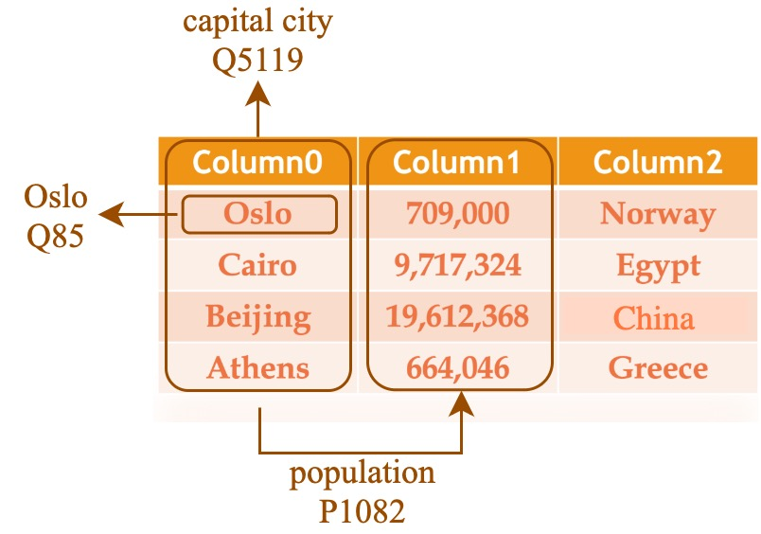
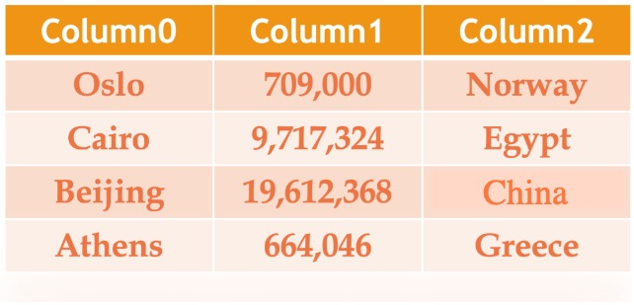
Data understanding through semantic annotation
Assignment of semantic tags to concepts, columns and relationships
Notes:
To address this challenge, our work focuses on exploring different methods for semantically annotating and understanding data tables.
Semantic tags are important because they carry the meaning of data.

Slide 7
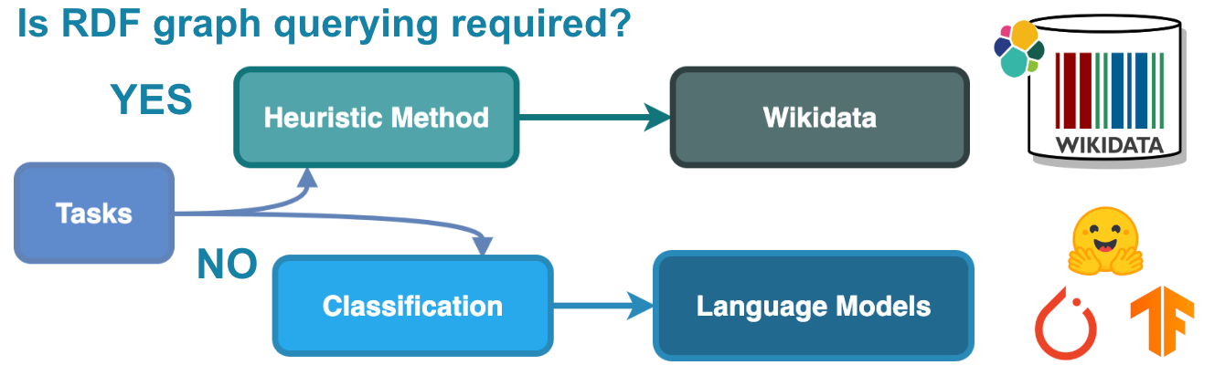
TorchicTab: A versatile semantic annotation system
Two complementary sub-systems:
Heuristic
Classification
TorchicTab
Notes:
Our work focuses on exploring different methods for semantically annotating and understanding data tables.
TorchicTab contains two complementary systems which I will now break down

Slide 8
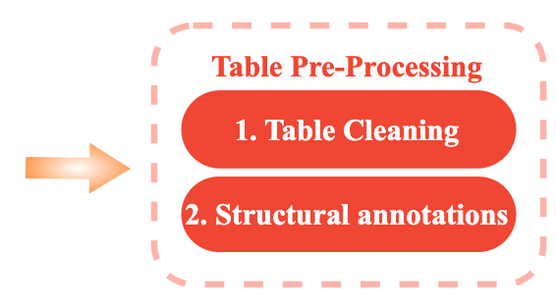
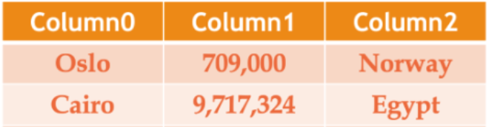
TorchicTab-Heuristic: Table pre-processing
L-column
NE-column
Table Cleaning
Noisy data removal
Incorrect encoding fix
Structural annotation
Column type understanding
Notes:
- The first step is to conduct simple table pre-processing, extracting initial structural annotations, such as the datatype of the columns, that come in-handy later during the process

Slide 9
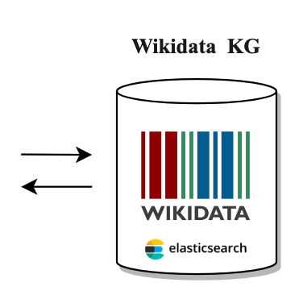
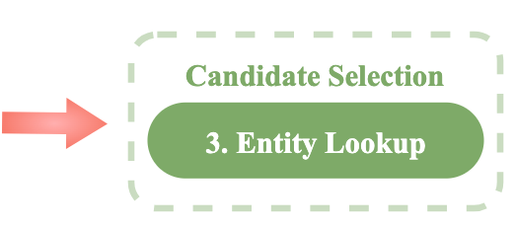
TorchicTab-Heuristic: Entity lookup
“Oslo” candidates
“Oslo” (Ship)
“Oslo” (Musical album)
“Oslo” (Capital of Norway)
“Osro” (Kansas community)
…
Notes:
In the entity lookup step, Wikidata candidates are retrieved for named entities of the table.
We implement different querying strategies to increase our candidate coverage, with the goal of including the true entities of the table in the candidates we retrieve.

Slide 10
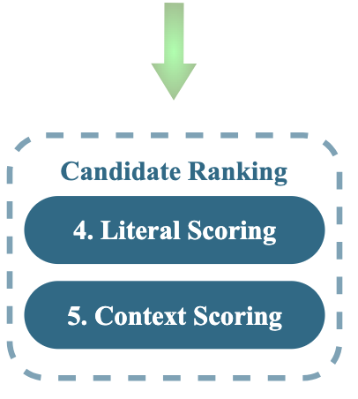
TorchicTab-Heuristic: Candidate ranking
Notes:
- We rank the retrieved candidates based on two factors. Their string similarity of their labels to the corresponding cell, and their contextual similarity to the rest of the row.

Slide 11
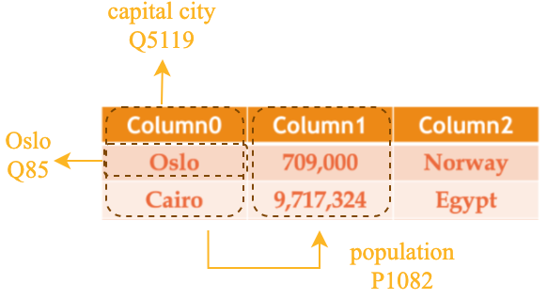
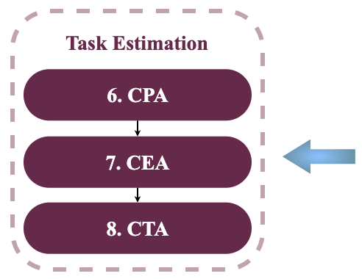

TorchicTab-Heuristic: Candidate ranking
Notes:
- Finally we are able to estimate semantic annotation tasks, such as semantically annotating table cells, table columns and relationships between columns

Slide 12

TorchicTab-Heuristic: Python Package
Repository link: https://github.com/dtai-kg/TorchicTab-Heuristic
Install via pip: pip install torchic_tab_heuristic
Notes:
- Finally we are able to estimate semantic annotation tasks, such as semantically annotating table cells, table columns and relationships between columns

Slide 13
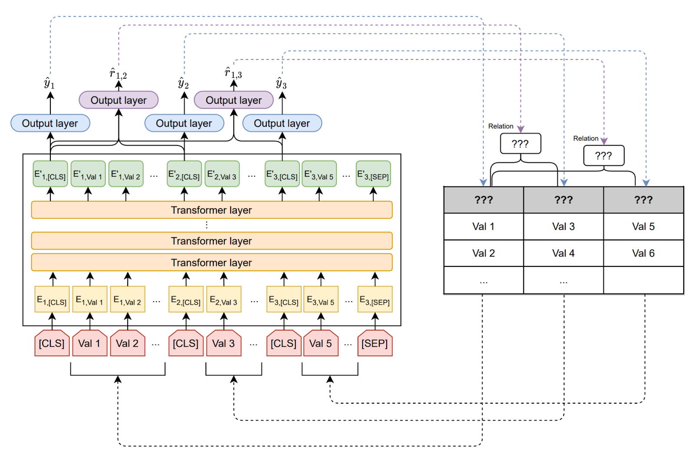
TorchicTab-Classification: DODUO Architecture
Semantic Annotations using (fine-tuned) LLMs
Notes:
- Off-the-shelf LLMs OR fine-tuned
We reuse a BERT architecture to encode the cells’ content using transformer layers and then train the output layers using a training set of annotated tables.
- This architecture allows the model take into consideration contextual information of other table columns, which proves very important in table understanding as it also is for natural language

Slide 14
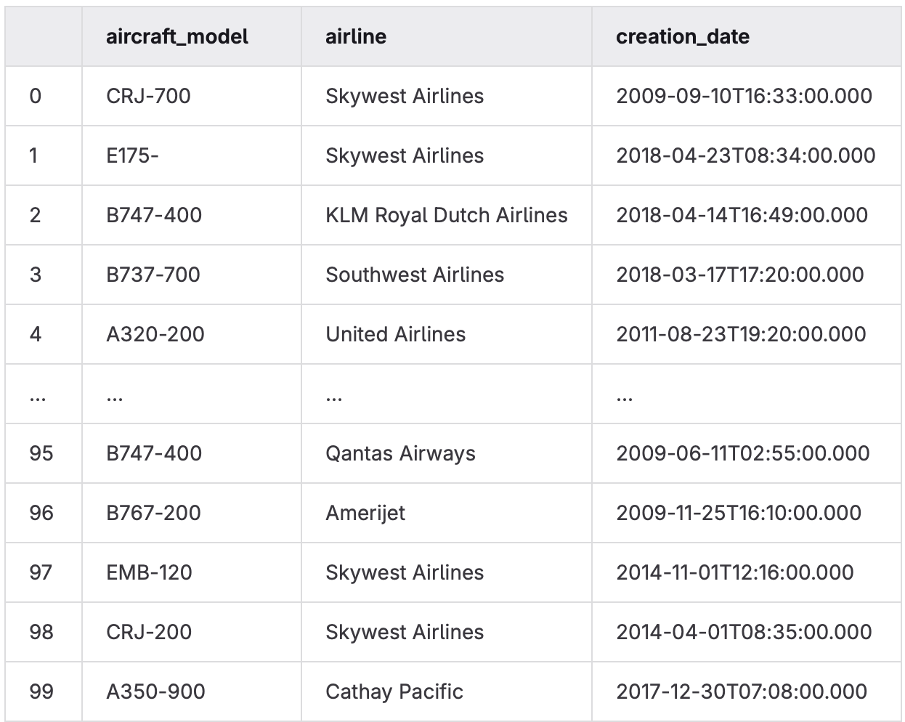

Demo: Data Understanding with TorchicTab
Understanding the data within an aircrafts dataset via semantic annotations
Tutorial link: https://github.com/dtai-kg/FlandersMake-Conference-Tutorial-2026
Notes:
- Finally we are able to estimate semantic annotation tasks, such as semantically annotating table cells, table columns and relationships between columns

Slide 15
Understanding, Integrating, and Discussing Data with LLMs
Data Understanding via Semantic Annotation
Data Enrichment via Annotation-Guided Querying
Automated Data Integration to Knowledge Graphs Leveraging Semantic Annotations
Rules-guided Data Exploration with LLMs
Notes:
Talk:
So now, I will go through step-by-step the process we have followed for making ML more reproducible using knowledge graphs.
Starting with the semantic modelling of Machine learning artefacts,
In order to formally represent complex knowledge related to the lifecycle of ML.

Slide 16
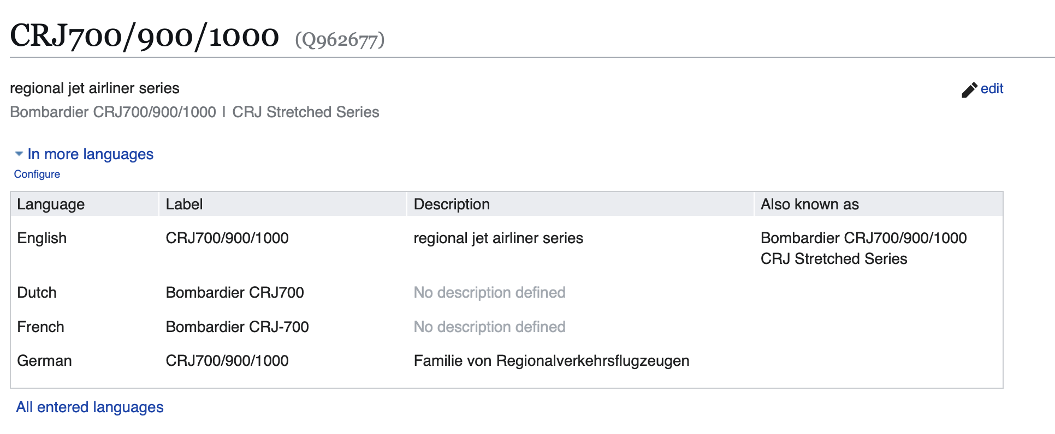
Data Enrichment Guided by Semantic Annotations
We can enrich our data leveraging the generated semantic annotations
Notes:
Matching our data with entities on the web enables us to enrich them

Slide 17
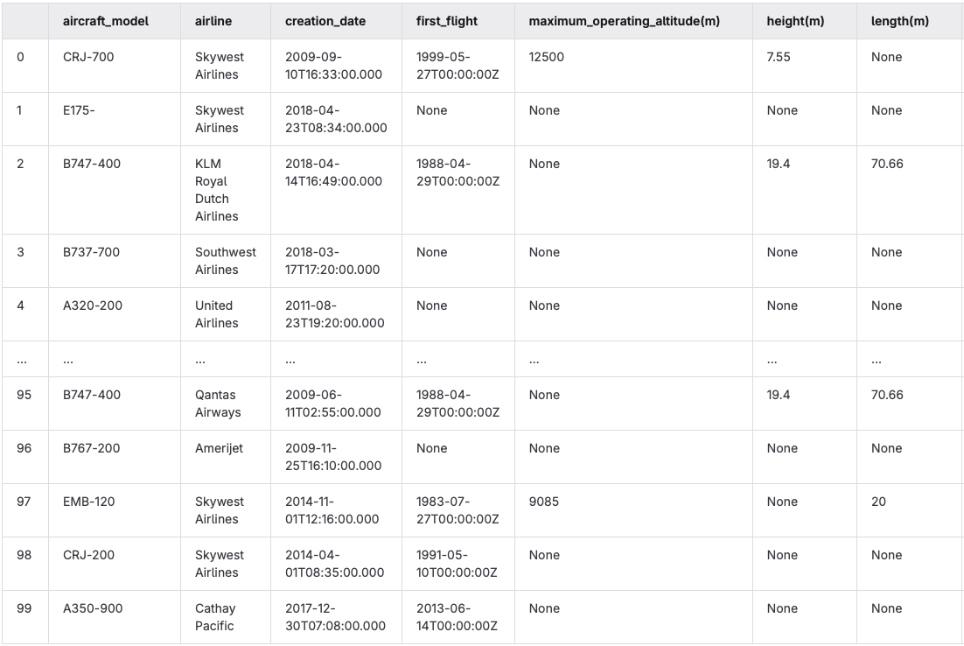
Demo: Data Enrichment Guided by Semantic Annotations
Tutorial link: https://github.com/dtai-kg/FlandersMake-Conference-Tutorial-2026
Notes:
- Finally we are able to estimate semantic annotation tasks, such as semantically annotating table cells, table columns and relationships between columns

Slide 18
Understanding, Integrating, and Discussing Data with LLMs
Data Understanding via Semantic Annotation
Data Enrichment via Annotation-Guided Querying
Automated Data Integration to Knowledge Graphs Leveraging Semantic Annotations
Rules-guided Data Exploration with LLMs
Notes:
Talk:
So now, I will go through step-by-step the process we have followed for making ML more reproducible using knowledge graphs.
Starting with the semantic modelling of Machine learning artefacts,
In order to formally represent complex knowledge related to the lifecycle of ML.

Slide 19
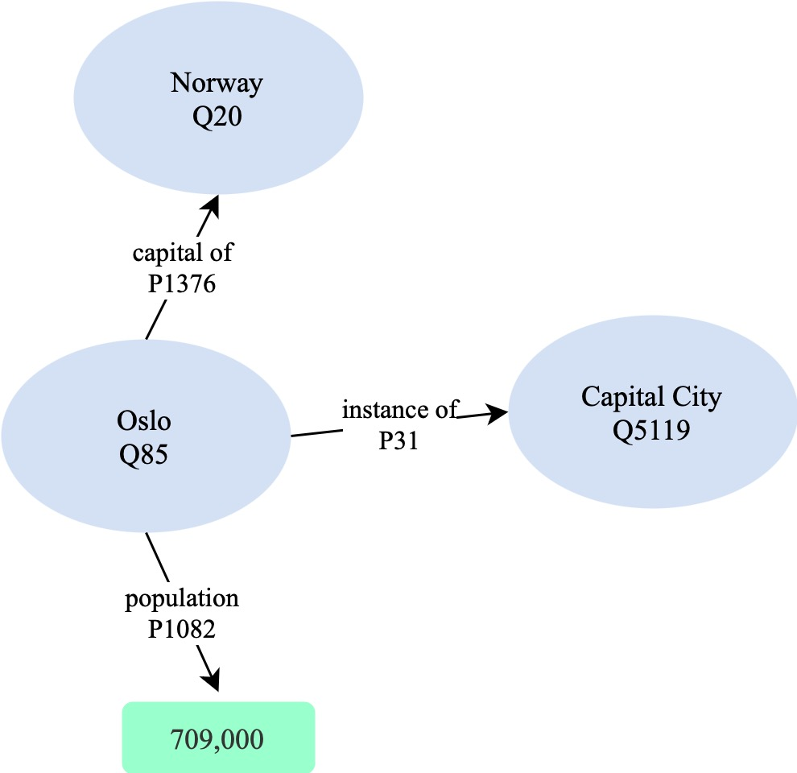
Automated Data Integration to Knowledge Graphs Leveraging Semantic Annotations
Semantic Annotations can be used to automatically transform and integrate data
Notes:
- Finally we are able to estimate semantic annotation tasks, such as semantically annotating table cells, table columns and relationships between columns

Slide 20
Why transform to knowledge graphs?
Knowledge graphs: Structured networks of interconnected entities and relationships
They offer:
Improved search and discovery of connections through complex relationships between data points
Enhanced reasoning and inference by linking heterogeneous data
Scalability and flexibility through easy integration of new information
Notes:
- Finally we are able to estimate semantic annotation tasks, such as semantically annotating table cells, table columns and relationships between columns

Slide 21
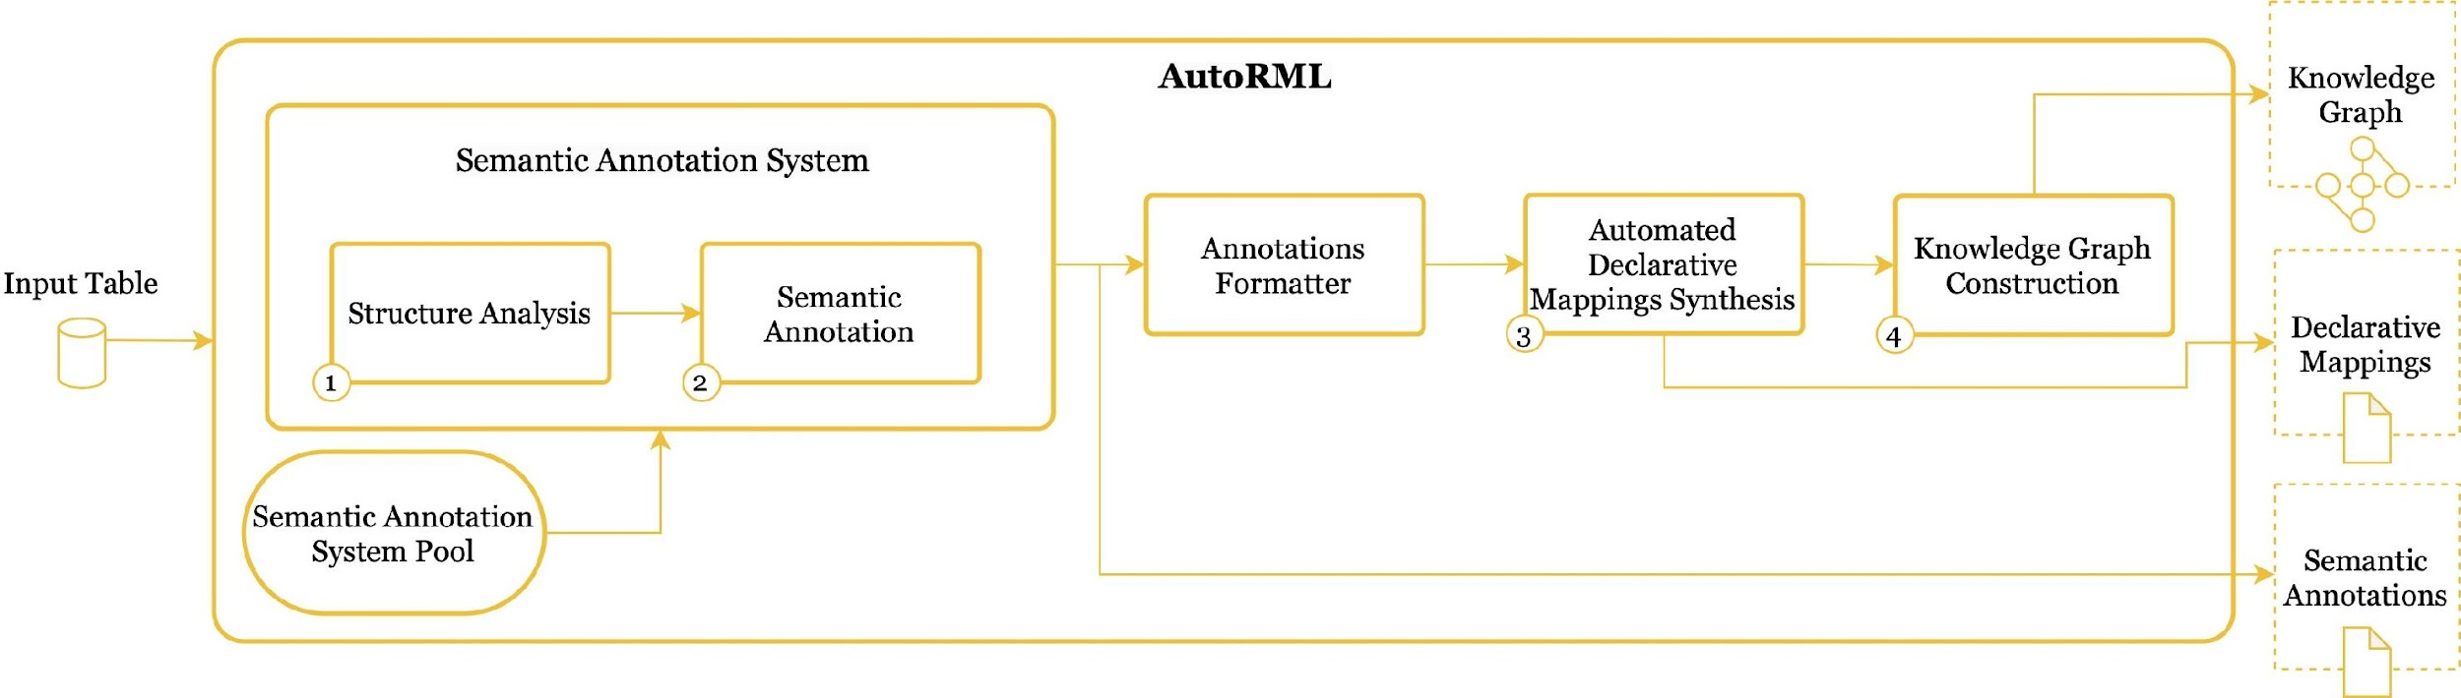
AutoRML: Automated Knowledge Graph Construction using Semantic Annotations
Semantic annotations are used to automatically generate data transformation mappings
Notes:
- Finally we are able to estimate semantic annotation tasks, such as semantically annotating table cells, table columns and relationships between columns

Slide 22

AutoRML: Python Package
Repository link: https://github.com/dtai-kg/AutoRML
Install via pip: pip install autorml
Notes:
- Finally we are able to estimate semantic annotation tasks, such as semantically annotating table cells, table columns and relationships between columns

Slide 23
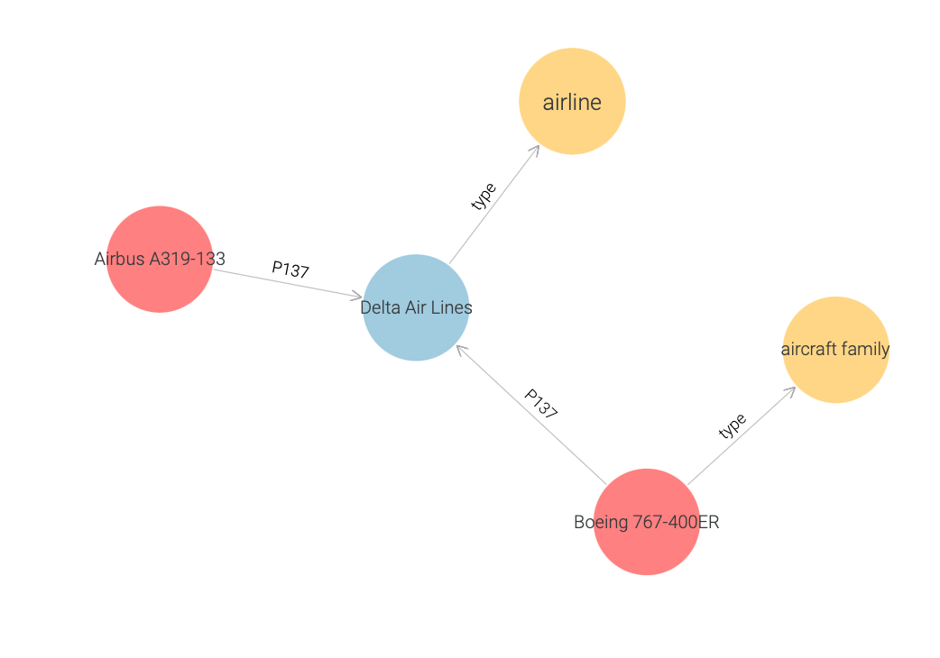
Demo: Automated Knowledge Graph Construction
with AutoRML
Tutorial link: https://github.com/dtai-kg/FlandersMake-Conference-Tutorial-2026
Notes:
- Finally we are able to estimate semantic annotation tasks, such as semantically annotating table cells, table columns and relationships between columns

Slide 24
Understanding, Integrating, and Discussing Data with LLMs
Data Understanding via Semantic Annotation
Data Enrichment via Annotation-Guided Querying
Automated Data Integration to Knowledge Graphs Leveraging Semantic Annotations
Rules-guided Data Exploration with LLMs

Slide 25
Need for User-Friendly Data Exploration
Data exploration is necessary but often challenging:
Non-technical users find it difficult to query data
Query languages vary, depending on data model
Hence, there is a need for natural language data querying to allow user-friendly
data exploration.
LLMs provide new avenues to do that effectively, but might often:
Hallucinate
Generate inaccurate / incomplete results
Notes:
- Finally we are able to estimate semantic annotation tasks, such as semantically annotating table cells, table columns and relationships between columns

Slide 26










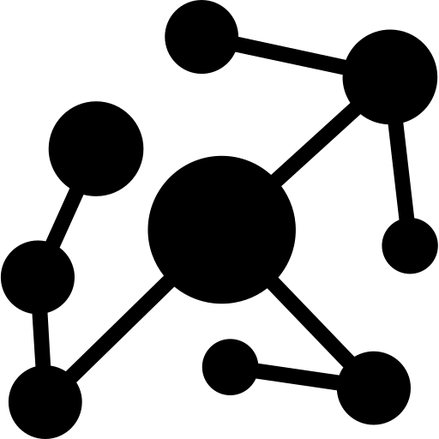




Natural Language Annotation-Guided Data Exploration
with LLMs
searching websites…
searching knowledge graph…
Automating Web UI
Web Interface
Endpoint
Database
Notes:
- Finally we are able to estimate semantic annotation tasks, such as semantically annotating table cells, table columns and relationships between columns

Slide 27
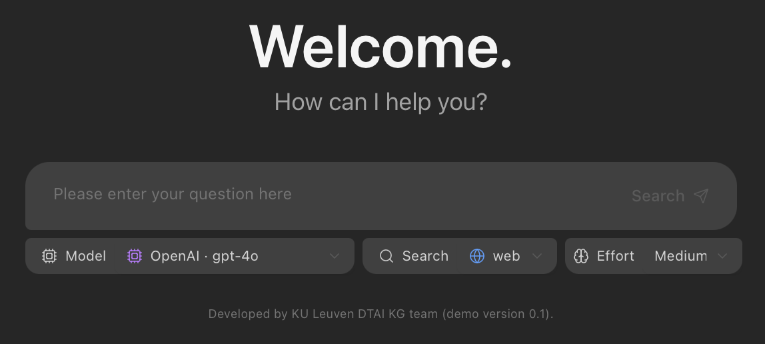
Demo: Natural Language Data Exploration with LLMs
Notes:
- Finally we are able to estimate semantic annotation tasks, such as semantically annotating table cells, table columns and relationships between columns

Slide 28
The importance of data understanding across applications
We showed how data understanding:
a. Can be achieved with data retrieval or LLM techniques

Slide 29
The importance of data understanding across applications
We showed how data understanding:
b. Enables data enrichment

Slide 30
The importance of data understanding across applications
We showed how data understanding:
c. Enables automated data transformation

Slide 31
The importance of data understanding across applications
We showed how data understanding:
d. Enables controlled data exploration with LLMs

Slide 32
Understanding, Integrating, and Discussing Data with LLMs
Ioannis Dasoulas, Duo Yang, Xuemin Duan, Anastasia Dimou
DTAI, KU Leuven
{first_name.last_name}@kuleuven.be

